Slide 1
Data and Computer Communications
Chapter 17 – Wireless LANs
Ninth Edition
by William Stallings
Notes:
“Data and Computer Communications”, 9/e, by William Stallings, Chapter 17 “Wireless LANs”.

Slide 2
High Speed LANs
Investigators have published numerous reports of birds taking turns vocalizing; the bird spoken to gave its full attention to the speaker and never vocalized at the same time, as if the two were holding a conversation
Researchers and scholars who have studied the data on avian communication carefully write the (a) the communication code of birds such has crows has not been broken by any means; (b) probably all birds have wider vocabularies than anyone realizes; and (c) greater complexity and depth are recognized in avian communication as research progresses.
—The Human Nature of Birds,
Theodore Barber
Notes:
This quote is from the start of Stallings DCC9e Chapter 17. In just the past few years, wireless LANs have come to occupy a significant niche in the local area network market. Increasingly, organizations are finding that wireless LANs are an indispensable adjunct to traditional wired LANs, to satisfy requirements for mobility, relocation, ad hoc networking, and coverage of locations difficult to wire. This chapter provides a survey of wireless LANs.

Slide 3
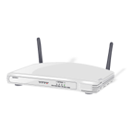
Overview of Wireless LANs
wireless transmission medium
issues of high prices, low data rates, occupational safety concerns, & licensing requirements now addressed
key application areas:
LAN extension
cross-building interconnect
nomadic access
ad hoc networking
Notes:
A wireless LAN makes use of a wireless transmission medium. Until relatively recently, wireless LANs were little used. The reasons for this included high prices, low data rates, occupational safety concerns, and licensing requirements. As these problems have been addressed, the popularity of wireless LANs has grown rapidly.
[PAHL95] lists four application areas for wireless LANs: LAN extension, cross-building interconnect, nomadic access, and ad hoc networks.

Slide 4
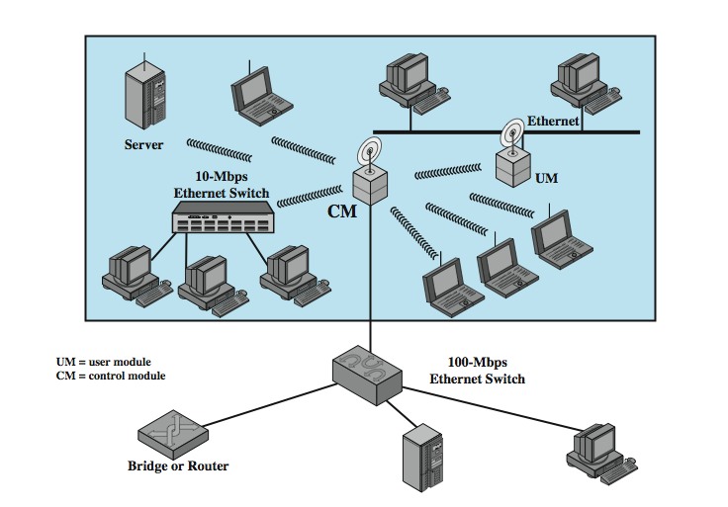
Single Cell LAN Extension
Notes:
Early wireless LAN products, introduced in the late 1980s, were marketed as substitutes for traditional wired LANs. A wireless LAN saves the cost of the installation of LAN cabling and eases the task of relocation and other modifications to network structure. However, this motivation for wireless LANs was overtaken by events. First, as awareness of the need for LANs became greater, architects designed new buildings to include extensive prewiring for data applications. Second, with advances in data transmission technology, there is an increasing reliance on twisted pair cabling for LANs. Most buildings are now wired with an abundance of data-grade cable, and many newer buildings are prewired with Category 5. Thus, the use of a wireless LAN to replace wired LANs has not happened to any great extent.
However, in a number of environments, there is a role for the wireless LAN as an alternative to a wired LAN. Examples include buildings with large open areas, such as manufacturing plants, stock exchange trading floors, and warehouses; historical buildings with insufficient twisted pair and where drilling holes for new wiring is prohibited; and small offices where installation and maintenance of wired LANs is not economical. In all of these cases, a wireless LAN provides an effective and more attractive alternative. In most of these cases, an organization will also have a wired LAN to support servers and some stationary workstations. For example, a manufacturing facility typically has an office area that is separate from the factory floor but that must be linked to it for networking purposes. Therefore, typically, a wireless LAN will be linked into a wired LAN on the same premises. Thus, this application area is referred to as LAN extension.
Stallings DCC9e Figure 17.1 indicates a simple wireless LAN configuration that is typical of many environments. There is a backbone wired LAN, such as Ethernet, that supports servers, workstations, and one or more bridges or routers to link with other networks. In addition, there is a control module (CM) that acts as an interface to a wireless LAN. The control module includes either bridge or router functionality to link the wireless LAN to the backbone. It includes some sort of access control logic, such as a polling or token-passing scheme, to regulate the access from the end systems. Note that some of the end systems are standalone devices, such as a workstation or a server. Hubs or other user modules (UMs) that control a number of stations off a wired LAN may also be part of the wireless LAN configuration.
The configuration of Figure 17.1 can be referred to as a single-cell wireless LAN; all of the wireless end systems are within range of a single control module.

Slide 5
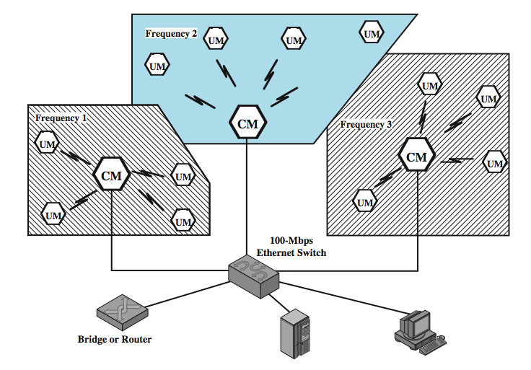
Multi Cell LAN Extension
Notes:
Another common configuration, suggested by Stallings DCC9e Figure 17.2, is a multiple-cell wireless LAN. In this case, there are multiple control modules interconnected by a wired LAN. Each control module supports a number of wireless end systems within its transmission range. For example, with an infrared LAN, transmission is limited to a single room; therefore, one cell is needed for each room in an office building that requires wireless support.

Slide 6
Cross-Building Interconnect
used to connect wired or wireless LANs in nearby buildings
point-to-point wireless link used
not a LAN per se
connect bridges or routers
Notes:
Another use of wireless LAN technology is to connect LANs in nearby buildings, be they wired or wireless LANs. In this case, a point-to-point wireless link is used between two buildings. For example two microwave or infrared transmitter/receiver units can be placed on the rooftops of two buildings within the line of sight of each other. The devices so connected are typically bridges or routers. This single point-to-point link is not a LAN per se, but it is usual to include this application under the heading of wireless LAN.

Slide 7
Nomadic Access
link LAN hub & mobile data terminal
laptop or notepad computer
enable employee to transfer data from portable computer to server
also useful in extended environment such as campus or cluster of buildings
users move around with portable computers
access to servers on wired LAN
Notes:
Nomadic access provides a wireless link between a LAN hub and a mobile data terminal equipped with an antenna, such as a laptop computer or notepad computer. One example of the utility of such a connection is to enable an employee returning from a trip to transfer data from a personal portable computer to a server in the office. Nomadic access is also useful in an extended environment such as a campus or a business operating out of a cluster of buildings. In both of these cases, users may move around with their portable computers and may wish access to the servers on a wired LAN from various locations.

Slide 8
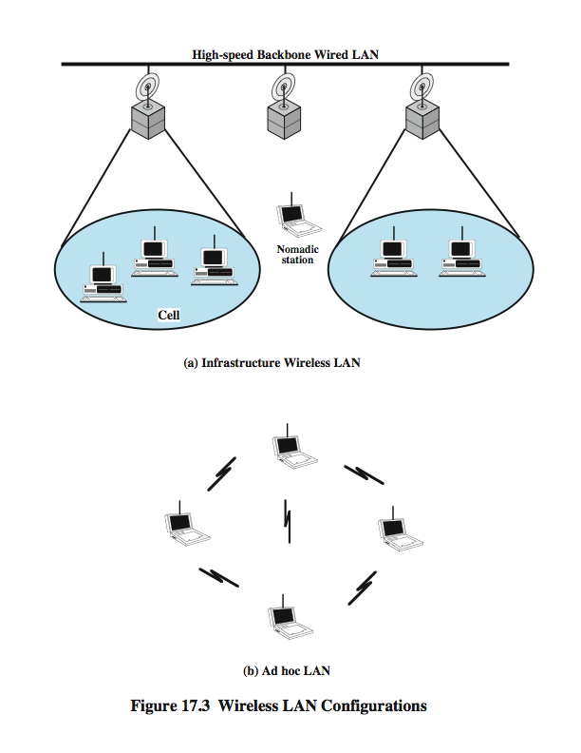
Infrastructure Wireless LAN
Notes:
Stallings DCC9e Figure 17.3 suggests the differences between a wireless LAN that supports LAN extension and nomadic access requirements and an ad hoc wireless LAN. In the former case, the wireless LAN forms a stationary infrastructure consisting of one or more cells with a control module for each cell. Within a cell, there may be a number of stationary end systems. Nomadic stations can move from one cell to another. In contrast, there is no infrastructure for an ad hoc network. Rather, a peer collection of stations within range of each other may dynamically configure themselves into a temporary network.

Slide 9
Ad Hoc Networking
temporary peer-to-peer network
Notes:
An ad hoc network is a peer-to-peer network (no centralized server) set up temporarily to meet some immediate need. For example, a group of employees, each with a laptop or palmtop computer, may convene in a conference room for a business or classroom meeting. The employees link their computers in a temporary network just for the duration of the meeting.
Stallings DCC8e Figure 17.3 suggests the differences between a wireless LAN that supports LAN extension and nomadic access requirements and an ad hoc wireless LAN. In contrast to the previous slide, there is no infrastructure for an ad hoc network. Rather, a peer collection of stations within range of each other may dynamically configure themselves into a temporary network.

Slide 10
Wireless LAN Requirements
THROUGHPUT – should make efficient use of medium
NUMBER OF NODES- hundreds of nodes across multiple cells
CONNECTION TO BACKBONE LAN – use of control modules
SERVICE AREA – coverage area of 100 to 300m
BATTERY POWER CONSUMPTION – reduce power consumption while not in use
TRANSMISSION ROBUST AND SECURITY– reliability and privacy/security
COLLOCATED NETWORK OPERATION – possible interference between LANs
LICENSE-FREE OPERATION – not having to secure a license for the frequency band used by the LAN
HANDOFF/ROAMING– enable stations to move from one cell to another
DYNAMIC CONFIGURATION- addition, deletion, relocation of end systems without disruption
Notes:
A wireless LAN must meet the same sort of requirements typical of any LAN, including high capacity, ability to cover short distances, full connectivity among attached stations, and broadcast capability. In addition, there are a number of requirements specific to the wireless LAN environment. The following are among the most important requirements for wireless LANs:
Throughput: The medium access control protocol should make as efficient use as possible of the wireless medium to maximize capacity.
Number of nodes: Wireless LANs may need to support hundreds of nodes across multiple cells.
Connection to backbone LAN: In most cases, interconnection with stations on a wired backbone LAN is required. For infrastructure wireless LANs, this is easily accomplished through the use of control modules that connect to both types of LANs. There may also need to be accommodation for mobile users and ad hoc wireless networks.
Service area: A typical coverage area for a wireless LAN has a diameter of 100 to 300 m.
Battery power consumption: Mobile workers use battery-powered workstations that need to have a long battery life when used with wireless adapters. This suggests that a MAC protocol that requires mobile nodes to monitor access points constantly or engage in frequent handshakes with a base station is inappropriate. Typical wireless LAN implementations have features to reduce power consumption while not using the network, such as a sleep mode.
Transmission robustness and security: Unless properly designed, a wireless LAN may be especially vulnerable to interference and eavesdropping. The design of a wireless LAN must permit reliable transmission even in a noisy environment and should provide some level of security from eavesdropping.
Collocated network operation: As wireless LANs become more popular, it is quite likely for two or more wireless LANs to operate in the same area or in some area where interference between the LANs is possible. Such interference may thwart the normal operation of a MAC algorithm and may allow unauthorized access to a particular LAN.
License-free operation: Users would prefer to buy and operate wireless LAN products without having to secure a license for the frequency band used by the LAN.
Handoff/roaming: The MAC protocol used in the wireless LAN should enable mobile stations to move from one cell to another.
Dynamic configuration: The MAC addressing and network management aspects of the LAN should permit dynamic and automated addition, deletion, and relocation of end systems without disruption to other users.

Slide 11
Wireless LANs
spread spectrum LANs
mostly operate in ISM (industrial, scientific, and medical) bands
OFDM LANs
orthogonal frequency division multiplexing
superior to spread spectrum
no Federal Communications Commission (FCC) licensing is required in USA
operate in 2.4 GHz or 5 GHz band
infrared (IR) LANs
individual cell of IR LAN limited to single room
IR light does not penetrate opaque walls
Notes:
Wireless LANs are generally categorized according to the transmission technique that is used. All current wireless LAN products fall into one of the following categories:
Spread spectrum LANs: This type of LAN makes use of spread spectrum transmission technology. In most cases, these LANs operate in the ISM (industrial, scientific, and medical) 2.4-GHz microwave bands so that no Federal Communications Commission (FCC) licensing is required for their use in the United States.
OFDM LANs: For higher speeds, a technology known as orthogonal frequency division multiplexing is superior to spread spectrum, and products with this technology are now common. These LANs typically operate in either the 2.4-GHz band or the 5-GHz band.
Infrared (IR) LANs: An individual cell of an IR LAN is limited to a single room, because infrared light does not penetrate opaque walls. This type of LAN is little used
The remainder of this section provides a brief overview of some aspects of spread spectrum and OFDM LANs.

Slide 12
Spread Spectrum LAN Configuration
usually use multiple-cell arrangement
adjacent cells use different center frequencies
Configurations
hub
connected to wired LAN
peer-to-peer
no hub
connect to stations on wired LAN and in other cells
may do automatic handoff
MAC algorithm such as CSMA used to control access
for ad hoc LANs
Notes:
Except for quite small offices, a wireless LAN makes use of a multiple-cell arrangement, as was illustrated in Stallings DCC9e Figure 17.2. Adjacent cells make use of different center frequencies within the same band to avoid interference.
Within a given cell, the topology can be either hub or peer to peer. The hub topology is indicated in Figure 17.2. In a hub topology, the hub is typically mounted on the ceiling and connected to a backbone wired LAN to provide connectivity to stations attached to the wired LAN and to stations that are part of wireless LANs in other cells. The hub may also control access, as in the IEEE 802.11 point coordination function, described subsequently. The hub may also control access by acting as a multiport repeater with similar functionality to Ethernet multiport repeaters. In this case, all stations in the cell transmit only to the hub and receive only from the hub. Alternatively, and regardless of access control mechanism, each station may broadcast using an omnidirectional antenna so that all other stations in the cell may receive; this corresponds to a logical bus configuration.
One other potential function of a hub is automatic handoff of mobile stations. At any time, a number of stations are dynamically assigned to a given hub based on proximity. When the hub senses a weakening signal, it can automatically hand off to the nearest adjacent hub.
A peer-to-peer topology is one in which there is no hub. A MAC algorithm such as CSMA is used to control access. This topology is appropriate for ad hoc LANs.

Slide 13

Spread Spectrum LANs Transmission Issues
licensing regulations differ between countries
USA FCC allows in ISM band:
spread spectrum (1W), very low power (0.5W)
902 - 928 MHz (915-MHz band)
2.4 - 2.4835 GHz (2.4-GHz band)
5.725 - 5.825 GHz (5.8-GHz band)
2.4 GHz also in Europe and Japan
Interference
many devices around 900 MHz: cordless telephones, wireless microphones, and amateur radio
fewer devices at 2.4 GHz; microwave oven
little competition at 5.8 GHz
Notes:
A desirable, though not necessary, characteristic of a wireless LAN is that it be usable without having to go through a licensing procedure. The licensing regulations differ from one country to another, which complicates this objective. Within the United States, the FCC has authorized two unlicensed applications within the ISM band: spread spectrum systems, which can operate at up to 1 watt, and very low power systems, which can operate at up to 0.5 watts. Since the FCC opened up this band, its use for spread spectrum wireless LANs has become popular.
In the United States, three microwave bands have been set aside for unlicensed spread spectrum use: 902 - 928 MHz (915-MHz band), 2.4 - 2.4835 GHz (2.4-GHz band), and 5.725 - 5.825 GHz (5.8-GHz band). Of these, the 2.4 GHz is also used in this manner in Europe and Japan. The higher the frequency, the higher the potential bandwidth, so the three bands are of increasing order of attractiveness from a capacity point of view. In addition, the potential for interference must be considered. There are a number of devices that operate at around 900 MHz, including cordless telephones, wireless microphones, and amateur radio. There are fewer devices operating at 2.4 GHz; one notable example is the microwave oven, which tends to have greater leakage of radiation with increasing age. At present there is little competition at the 5.8 GHz-band; however, the higher the frequency band, in general the more expensive the equipment.

Slide 14
IEEE 802 Standards
Notes:
In 1990, the IEEE 802 Committee formed a new working group, IEEE 802.11, specifically devoted to wireless LANs, with a charter to develop a MAC protocol and physical medium specification. Since that time, the demand for WLANs, at different frequencies and data rates, has exploded. Keeping pace with this demand, the IEEE 802.11 working group has issued an ever-expanding list of standards (Stallings DCC9e Table 17.1). Stallings DCC9e Table 17.2 briefly defines key terms used in the IEEE 802.11 standard.
The Wi-Fi Alliance
The first 802.11 standard to gain broad industry acceptance was 802.11b. Although 802.11b products are all based on the same standard, there is always a concern whether products from different vendors will successfully interoperate. To meet this concern, the Wireless Ethernet Compatibility Alliance (WECA), an industry consortium, was formed in 1999. This organization, subsequently renamed the Wi-Fi (Wireless Fidelity) Alliance, created a test suite to certify interoperability for 802.11b products. The term used for certified 802.11b products is Wi-Fi. Wi-Fi certification has been extended to 802.11g products,. The Wi-Fi Alliance has also developed a certification process for 802.11a products, called Wi-Fi5. The Wi-Fi Alliance is concerned with a range of market areas for WLANs, including enterprise, home, and hot spots.

Slide 15
IEEE 802 Terminology
Notes:
Stallings DCC9e Table 17.2 briefly defines key terms used in the IEEE 802.11 standard.

Slide 16
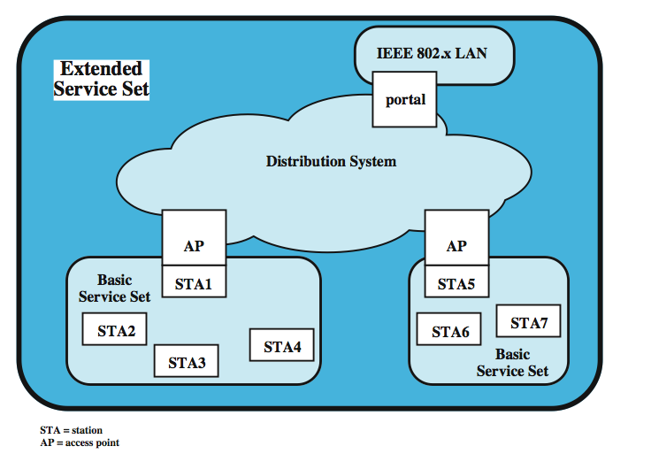
IEEE 802.11 Architecture
Notes:
Stallings DCC9e Figure 17.4 illustrates the model developed by the 802.11 working group. The smallest building block of a wireless LAN is a basic service set (BSS), which consists of some number of stations executing the same MAC protocol and competing for access to the same shared wireless medium. A BSS may be isolated or it may connect to a backbone distribution system (DS) through an access point (AP).
A simple configuration is shown in Figure 17.4, in which each station belongs to a single BSS; that is, each station is within wireless range only of other stations within the same BSS. It is also possible for two BSSs to overlap geographically, so that a single station could participate in more than one BSS. Further, the association between a station and a BSS is dynamic. Stations may turn off, come within range, and go out of range.

Slide 17
IEEE 802.11 - BSS
basic service set (BSS) building block
may be isolated
may connect to backbone distribution system (DS) through access point (AP)
BSS generally corresponds to cell
DS can be switch, wired network, or wireless network
have independent BSS (IBSS) with no AP
Notes:
The AP functions as a bridge and a relay point. In a BSS, client stations do not communicate directly with one another. Rather, if one station in the BSS wants to communicate with another station in the same BSS, the MAC frame is first sent from the originating station to the AP, and then from the AP to the destination station. Similarly, a MAC frame from a station in the BSS to a remote station is sent from the local station to the AP and then relayed by the AP over the DS on its way to the destination station. The BSS generally corresponds to what is referred to as a cell in the literature. The DS can be a switch, a wired network, or a wireless network.
When all the stations in the BSS are mobile stations, with no connection to other BSSs, the BSS is called an independent BSS (IBSS). An IBSS is typically an ad hoc network. In an IBSS, the stations all communicate directly, and no AP is involved.

Slide 18
Extended Service Set (ESS)
possible configurations:
simplest is each station belongs to single BSS
can have two BSSs overlap
a station can participate in more than one BSS
association between station and BSS dynamic
ESS is two or more BSS interconnected by DS
appears as single logical LAN to LLC
Notes:
An extended service set (ESS) consists of two or more basic service sets interconnected by a distribution system. Typically, the distribution system is a wired backbone LAN but can be any communications network. The extended service set appears as a single logical LAN to the logical link control (LLC) level.
Stallings DCC9e Figure 17.4 indicates that an AP is implemented as part of a station; the AP is the logic within a station that provides access to the DS by providing DS services in addition to acting as a station. To integrate the IEEE 802.11 architecture with a traditional wired LAN, a portal is used. The portal logic is implemented in a device, such as a bridge or router, that is part of the wired LAN and that is attached to the DS.

Slide 19
IEEE 802 Services
Notes:
IEEE 802.11 defines nine services that need to be provided by the wireless LAN to provide functionality equivalent to that which is inherent to wired LANs. Stallings DCC9e Table 17.3 lists the services and indicates two ways of categorizing them.
1. The service provider can be either the station or the DS. Station services are implemented in every 802.11 station, including AP stations. Distribution services are provided between BSSs; these services may be implemented in an AP or in another special-purpose device attached to the distribution system.
2. Three of the services are used to control IEEE 802.11 LAN access and confidentiality. Six of the services are used to support delivery of MAC service data units (MSDUs) between stations. The MSDU is a block of data passed down from the MAC user to the MAC layer; typically this is a LLC PDU. If the MSDU is too large to be transmitted in a single MAC frame, it may be fragmented and transmitted in a series of MAC frames. Fragmentation is discussed in Section 17.4.
Following the IEEE 802.11 document, we next discuss the services in an order designed to clarify the operation of an IEEE 802.11 ESS network. MSDU delivery, which is the basic service, has already been mentioned. Services related to security are discussed in Section17.6.

Slide 20
Services - Message Distribution
distribution service
primary service used by stations to exchange MAC frames when frame must traverse DS
if stations in same BSS, distribution service logically goes through single AP of that BSS
integration service
enables transfer of data between 802.11 LAN station and one on an integrated 802.x LAN
Notes:
The two services involved with the distribution of messages within a DS are distribution and integration. Distribution is the primary service used by stations to exchange MAC frames when the frame must traverse the DS to get from a station in one BSS to a station in another BSS. For example, suppose a frame is to be sent from station 2 (STA 2) to STA 7 in Stallings DCC9e Figure 17.4. The frame is sent from STA 2 to STA 1, which is the AP for this BSS. The AP gives the frame to the DS, which has the job of directing the frame to the AP associated with STA 5 in the target BSS. STA 5 receives the frame and forwards it to STA 7. How the message is transported through the DS is beyond the scope of the IEEE 802.11 standard.
If the two stations that are communicating are within the same BSS, then the distribution service logically goes through the single AP of that BSS.
The integration service enables transfer of data between a station on an IEEE 802.11 LAN and a station on an integrated IEEE 802.x LAN. The term integrated refers to a wired LAN that is physically connected to the DS and whose stations may be logically connected to an IEEE 802.11 LAN via the integration service. The integration service takes care of any address translation and media conversion logic required for the exchange of data.

Slide 21
Association Related Services
DS requires info about stations within ESS
provided by association-related services
station must associate before communicating
3 mobility transition types:
no transition - stationary or in single BSS
BSS transition - between BSS in same ESS
ESS transition: between BSS in different ESS
Notes:
The primary purpose of the MAC layer is to transfer MSDUs between MAC entities; this purpose is fulfilled by the distribution service. For that service to function, it requires information about stations within the ESS that is provided by the association-related services. Before the distribution service can deliver data to or accept data from a station, that station must be associated. Before looking at the concept of association, we need to describe the concept of mobility. The standard defines three transition types, based on mobility:
No transition: A station of this type is either stationary or moves only within the direct communication range of the communicating stations of a single BSS.
BSS transition: This is defined as a station movement from one BSS to another BSS within the same ESS. In this case, delivery of data to the station requires that the addressing capability be able to recognize the new location of the station.
ESS transition: This is defined as a station movement from a BSS in one ESS to a BSS within another ESS. This case is supported only in the sense that the station can move. Maintenance of upper-layer connections supported by 802.11 cannot be guaranteed. In fact, disruption of service is likely to occur.

Slide 22
Association Related Services
DS needs identity of destination station
stations must maintain association with AP within current BSS
3 services relate to this requirement:
Association - establishes initial association between station and AP
Reassociation - to transfer an association to another AP
Disassociation - by station or AP
Notes:
To deliver a message within a DS, the distribution service needs to know where the destination station is located. Specifically, the DS needs to know the identity of the AP to which the message should be delivered in order for that message to reach the destination station. To meet this requirement, a station must maintain an association with the AP within its current BSS. Three services relate to this requirement:
Association: Establishes an initial association between a station and an AP. Before a station can transmit or receive frames on a wireless LAN, its identity and address must be known. For this purpose, a station must establish an association with an AP within a particular BSS. The AP can then communicate this information to other APs within the ESS to facilitate routing and delivery of addressed frames.
Reassociation: Enables an established association to be transferred from one AP to another, allowing a mobile station to move from one BSS to another.
Disassociation: A notification from either a station or an AP that an existing association is terminated. A station should give this notification before leaving an ESS or shutting down. However, the MAC management facility protects itself against stations that disappear without notification.

Slide 23
Medium Access Control
MAC layer covers three functional areas:
reliable data delivery
access control
security
Notes:
The IEEE 802.11 MAC layer covers three functional areas: reliable data delivery, access control, and security. This section covers the first two topics.

Slide 24
Reliable Data Delivery
can be dealt with at a higher layer
more efficient to deal with errors at MAC level
802.11 includes frame exchange protocol
station receiving frame returns acknowledgment (ACK) frame
exchange treated as atomic unit
if no ACK within short period of time, retransmit
802.11 physical and MAC layers unreliable
noise, interference, and other propagation effects result in loss of frames
even with error-correction codes, frames may not successfully be received
Notes:
As with any wireless network, a wireless LAN using the IEEE 802.11 physical and MAC layers is subject to considerable unreliability. Noise, interference, and other propagation effects result in the loss of a significant number of frames. Even with error correction codes, a number of MAC frames may not successfully be received. This situation can be dealt with by reliability mechanisms at a higher layer, such as TCP. However, timers used for retransmission at higher layers are typically on the order of seconds. It is therefore more efficient to deal with errors at the MAC level. For this purpose, IEEE 802.11 includes a frame exchange protocol. When a station receives a data frame from another station, it returns an acknowledgment (ACK) frame to the source station. This exchange is treated as an atomic unit, not to be interrupted by a transmission from any other station. If the source does not receive an ACK within a short period of time, either because its data frame was damaged or because the returning ACK was damaged, the source retransmits the frame.

Slide 25
Four Frame Exchange
RTS alerts all stations within range of source that exchange is under way
CTS alerts all stations within range of destination
other stations don’t transmit to avoid collision
RTS/CTS exchange is required function of MAC but may be disabled
can use four-frame exchange for better reliability
source issues a Request to Send (RTS) frame
destination responds with Clear to Send (CTS)
after receiving CTS, source transmits data
destination responds with ACK
Notes:
Thus, the basic data transfer mechanism in IEEE 802.11 involves an exchange of two frames. To further enhance reliability, a four-frame exchange may be used. In this scheme, a source first issues a Request to Send (RTS) frame to the destination. The destination then responds with a Clear to Send (CTS). After receiving the CTS, the source transmits the data frame, and the destination responds with an ACK. The RTS alerts all stations that are within reception range of the source that an exchange is under way; these stations refrain from transmission in order to avoid a collision between two frames transmitted at the same time. Similarly, the CTS alerts all stations that are within reception range of the destination that an exchange is under way. The RTS/CTS portion of the exchange is a required function of the MAC but may be disabled.

Slide 26
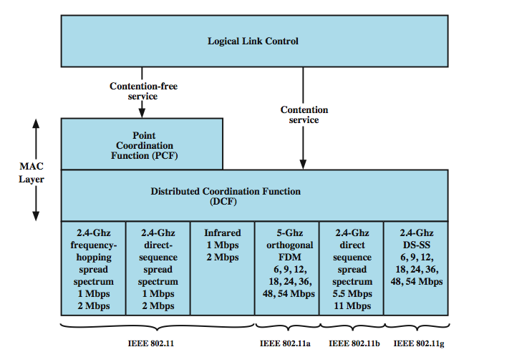
Media Access Control
Notes:
The 802.11 working group considered two types of proposals for a MAC algorithm: distributed access protocols, which, like Ethernet, distribute the decision to transmit over all the nodes using a carrier sense mechanism; and centralized access protocols, which involve regulation of transmission by a centralized decision maker. A distributed access protocol makes sense for an ad hoc network of peer workstations (typically an IBSS) and may also be attractive in other wireless LAN configurations that consist primarily of bursty traffic. A centralized access protocol is natural for configurations in which a number of wireless stations are interconnected with each other and some sort of base station that attaches to a backbone wired LAN; it is especially useful if some of the data is time sensitive or high priority.
The end result for 802.11 is a MAC algorithm called DFWMAC (distributed foundation wireless MAC) that provides a distributed access control mechanism with an optional centralized control built on top of that. Stallings DCC9e Figure 17.5 illustrates the architecture. The lower sublayer of the MAC layer is the distributed coordination function (DCF). DCF uses a contention algorithm to provide access to all traffic. Ordinary asynchronous traffic directly uses DCF. The point coordination function (PCF) is a centralized MAC algorithm used to provide contention-free service. PCF is built on top of DCF and exploits features of DCF to assure access for its users.

Slide 27
Distributed Coordination Function
DCF sublayer uses CSMA
no collision detection since on a wireless network
DCF includes delays that act as a priority scheme
if station has frame to send it listens to medium
if medium is idle, station may transmit
else waits until current transmission is complete
Notes:
The DCF sublayer makes use of a simple CSMA (carrier sense multiple access) algorithm. If a station has a MAC frame to transmit, it listens to the medium. If the medium is idle, the station may transmit; otherwise the station must wait until the current transmission is complete before transmitting. The DCF does not include a collision detection function (i.e., CSMA/CD) because collision detection is not practical on a wireless network. The dynamic range of the signals on the medium is very large, so that a transmitting station cannot effectively distinguish incoming weak signals from noise and the effects of its own transmission.
To ensure the smooth and fair functioning of this algorithm, DCF includes a set of delays that amounts to a priority scheme. Let us start by considering a single delay known as an interframe space (IFS). In fact, there are three different IFS values, but the algorithm is best explained by initially ignoring this detail.

Slide 28
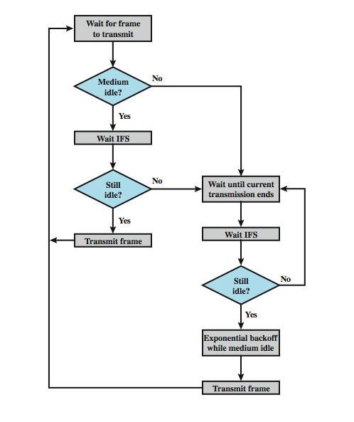
IEEE 802.11 Medium Access Control Logic
Notes:
Using an IFS, the rules for CSMA access are as follows (Stallings DCC9e Figure 17.6):
1. A station with a frame to transmit senses the medium. If the medium is idle, it waits to see if the medium remains idle for a time equal to IFS. If so, the station may transmit immediately.
2. If the medium is busy (either because the station initially finds the medium busy or because the medium becomes busy during the IFS idle time), the station defers transmission and continues to monitor the medium until the current transmission is over.
3. Once the current transmission is over, the station delays another IFS. If the medium remains idle for this period, then the station backs off a random amount of time and again senses the medium. If the medium is still idle, the station may transmit. During the backoff time, if the medium becomes busy, the backoff timer is halted and resumes when the medium becomes idle.
4. If the transmission is unsuccessful, which is determined by the absence of an acknowledgement, then it is assumed that a collision has occurred.
To ensure that backoff maintains stability, binary exponential backoff, described in Chapter 16, is used. Binary exponential backoff provides a means of handling a heavy load. Repeated failed attempts to transmit result in longer and longer backoff times, which helps to smooth out the load. Without such a backoff, the following situation could occur: Two or more stations attempt to transmit at the same time, causing a collision. These stations then immediately attempt to retransmit, causing a new collision.

Slide 29
Priority IFS Values
SIFS (short IFS)
for all immediate response actions
PIFS (point coordination function IFS)
used by the centralized controller in PCF scheme when issuing polls
DIFS (distributed coordination function IFS)
used as minimum delay for asynchronous frames contending for access
Notes:
The preceding scheme is refined for DCF to provide priority-based access by the simple expedient of using three values for IFS:
SIFS (short IFS): The shortest IFS, used for all immediate response actions, as explained in the following discussion
PIFS (point coordination function IFS): A midlength IFS, used by the centralized controller in the PCF scheme when issuing polls
DIFS (distributed coordination function IFS): The longest IFS, used as a minimum delay for asynchronous frames contending for access

Slide 30
SIFS Use
SIFS gives highest priority
over stations waiting PIFS or DIFS time
SIFS used in following circumstances:
Acknowledgment (ACK)
station responds with ACK after waiting SIFS gap
for efficient collision detect and multi-frame transmission
Clear to Send (CTS)
station ensures data frame gets through by issuing RTS
waits for CTS response from destination
Poll response
Notes:
Consider first the SIFS. Any station using SIFS to determine transmission opportunity has, in effect, the highest priority, because it will always gain access in preference to a station waiting an amount of time equal to PIFS or DIFS. The SIFS is used in the following circumstances:
Acknowledgment (ACK): When a station receives a frame addressed only to itself (not multicast or broadcast), it responds with an ACK frame after waiting only for an SIFS gap. This has two desirable effects. First, because collision detection is not used, the likelihood of collisions is greater than with CSMA/CD, and the MAC-level ACK provides for efficient collision recovery. Second, the SIFS can be used to provide efficient delivery of an LLC protocol data unit (PDU) that requires multiple MAC frames. In this case, the following scenario occurs. A station with a multiframe LLC PDU to transmit sends out the MAC frames one at a time. Each frame is acknowledged by the recipient after SIFS. When the source receives an ACK, it immediately (after SIFS) sends the next frame in the sequence. The result is that once a station has contended for the channel, it will maintain control of the channel until it has sent all of the fragments of an LLC PDU.
Clear to Send (CTS): A station can ensure that its data frame will get through by first issuing a small Request to Send (RTS) frame. The station to which this frame is addressed should immediately respond with a CTS frame if it is ready to receive. All other stations receive the RTS and defer using the medium.
Poll response: This is explained in the following discussion of PCF.

Slide 31
PIFS and DIFS Use
PIFS used by centralized controller
for issuing polls
take precedence over normal contention traffic
with the exception of SIFS
DIFS used for all ordinary asynchronous traffic
Notes:
The next longest IFS interval is the PIFS. This is used by the centralized controller in issuing polls and takes precedence over normal contention traffic. However, those frames transmitted using SIFS have precedence over a PCF poll.
Finally, the DIFS interval is used for all ordinary asynchronous traffic.

Slide 32
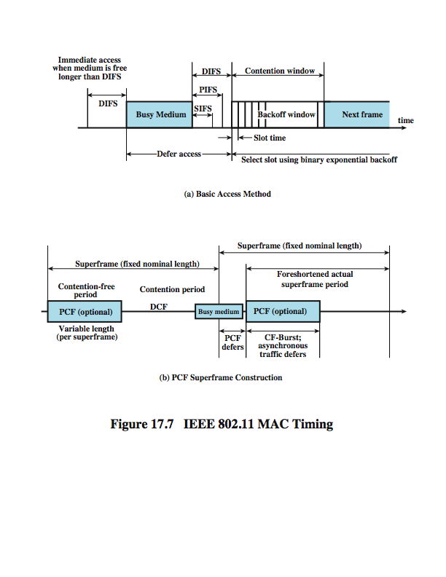
IEEE 802.11 MAC Timing Basic Access Method
Notes:
Stallings DCC9e Figure 17.7a illustrates the use of these time values.

Slide 33
Point Coordination Function (PCF)
alternative access method implemented on top of DCF
polling by centralized polling master (point coordinator)
uses PIFS when issuing polls
point coordinator polls in round-robin to stations configured for polling
when poll issued, polled station may respond using SIFS
if point coordinator receives response, it issues another poll using PIFS
if no response during expected turnaround time, coordinator issues poll
coordinator could lock out asynchronous traffic by issuing polls
have a superframe interval defined
Notes:
PCF is an alternative access method implemented on top of the DCF. The operation consists of polling by the centralized polling master (point coordinator). The point coordinator makes use of PIFS when issuing polls. Because PIFS is smaller than DIFS, the point coordinator can seize the medium and lock out all asynchronous traffic while it issues polls and receives responses.
As an extreme, consider the following possible scenario. A wireless network is configured so that a number of stations with time-sensitive traffic are controlled by the point coordinator while remaining traffic contends for access using CSMA. The point coordinator could issue polls in a round-robin fashion to all stations configured for polling. When a poll is issued, the polled station may respond using SIFS. If the point coordinator receives a response, it issues another poll using PIFS. If no response is received during the expected turnaround time, the coordinator issues a poll.
If the discipline of the preceding paragraph were implemented, the point coordinator would lock out all asynchronous traffic by repeatedly issuing polls. To prevent this, an interval known as the superframe is defined. During the first part of this interval, the point coordinator issues polls in a round-robin fashion to all stations configured for polling. The point coordinator then idles for the remainder of the superframe, allowing a contention period for asynchronous access.

Slide 34
PCF Superframe Timing
Notes:
Stallings DCC9e Figure 17.7b illustrates the use of the superframe. At the beginning of a superframe, the point coordinator may optionally seize control and issue polls for a given period of time. This interval varies because of the variable frame size issued by responding stations. The remainder of the superframe is available for contention-based access. At the end of the superframe interval, the point coordinator contends for access to the medium using PIFS. If the medium is idle, the point coordinator gains immediate access and a full superframe period follows. However, the medium may be busy at the end of a superframe. In this case, the point coordinator must wait until the medium is idle to gain access; this results in a foreshortened superframe period for the next cycle.

Slide 35
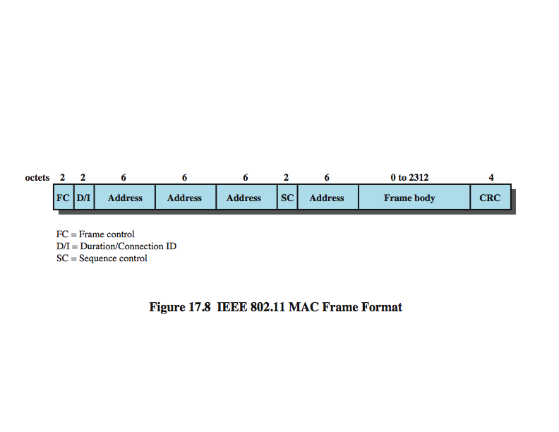
IEEE 802.11 MAC Frame Format
Notes:
Stallings DCC9e Figure 17.8 shows the 802.11 frame format. This general format is used for all data and control frames, but not all fields are used in all contexts. The fields are:
Frame Control: Indicates the type of frame (control, management, or data) and provides control information. Control information includes whether the frame is to or from a DS, fragmentation information, and privacy information.
Duration/Connection ID: If used as a duration field, indicates the time (in microseconds) the channel will be allocated for successful transmission of a MAC frame. In some control frames, this field contains an association, or connection, identifier.
Addresses: The number and meaning of the 48-bit address fields depend on context. The transmitter address and receiver address are the MAC addresses of stations joined to the BSS that are transmitting and receiving frames over the wireless LAN. The service set ID (SSID) identifies the wireless LAN over which a frame is transmitted. For an IBSS, the SSID is a random number generated at the time the network is formed. For a wireless LAN that is part of a larger configuration the SSID identifies the BSS over which the frame is transmitted; specifically, the SSID is the MAC-level address of the AP for this BSS (Stallings DCC9e Figure 17.4). Finally the source address and destination address are the MAC addresses of stations, wireless or otherwise, that are the ultimate source and destination of this frame. The source address may be identical to the transmitter address and the destination address may be identical to the receiver address.
Sequence Control: Contains a 4-bit fragment number subfield, used for fragmentation and reassembly, and a 12-bit sequence number used to number frames sent between a given transmitter and receiver.
Frame Body: Contains an MSDU or a fragment of an MSDU. The MSDU is a LLC protocol data unit or MAC control information.
Frame Check Sequence: A 32-bit cyclic redundancy check.

Slide 36
Control Frames
Power Save-Poll (PS-Poll)
request AP transmit buffered frame when in power-saving mode
Request to Send (RTS)
first frame in four-way frame exchange
Clear to Send (CTS)
second frame in four-way exchange
Acknowledgment (ACK)
acknowledges correct receipt
Contention-Free (CF)-end
announces end of contention-free period part of PCF
CF-End + CF-Ack:
acknowledges CF-end to end contention-free period and release stations from associated restrictions
Notes:
We now look at the three MAC frame types.
CONTROL FRAMES
Control frames assist in the reliable delivery of data frames. There are six control frame subtypes:
Power Save-Poll (PS-Poll): This frame is sent by any station to the station that includes the AP (access point). Its purpose is to request that the AP transmit a frame that has been buffered for this station while the station was in power-saving mode.
Request to Send (RTS): This is the first frame in the four-way frame exchange discussed under the subsection on reliable data delivery at the beginning of Stallings DCC9e Section 17.3. The station sending this message is alerting a potential destination, and all other stations within reception range, that it intends to send a data frame to that destination.
Clear to Send (CTS): This is the second frame in the four-way exchange. It is sent by the destination station to the source station to grant permission to send a data frame.
Acknowledgment: Provides an acknowledgment from the destination to the source that the immediately preceding data, management, or PS-Poll frame was received correctly.
Contention-Free (CF)-end: Announces the end of a contention-free period that is part of the point coordination function.
CF-End + CF-Ack: Acknowledges the CF-end. This frame ends the contention-free period and releases stations from the restrictions associated with that period.

Slide 37
Data Frames – Data Carrying
eight data frame subtypes
organized in two groups
first four carry upper-level data
remaining do not carry any user data
Data
simplest data frame, contention or contention-free use
Data + CF-Ack
carries data and acknowledges previously received data during contention-free period
Data + CF-Poll
used by point coordinator to deliver data & request send
Data + CF-Ack + CF-Poll
combines Data + CF-Ack and Data + CF-Poll
Notes:
There are eight data frame subtypes, organized into two groups. The first four subtypes define frames that carry upper-level data from the source station to the destination station. The four data-carrying frames are:
Data: This is the simplest data frame. It may be used in both a contention period and a contention-free period.
Data + CF-Ack: May only be sent during a contention-free period. In addition to carrying data, this frame acknowledges previously received data.
Data + CF-Poll: Used by a point coordinator to deliver data to a mobile station and also to request that the mobile station send a data frame that it may have buffered.
Data + CF-Ack + CF-Poll: Combines the functions of the Data + CF-Ack and Data + CF-Poll into a single frame.

Slide 38
Data Frames – Not Data Carrying
Null Function
carries no data, polls, or acknowledgments
carries power management bit in frame control field to AP
indicates station is changing to low-power state
other three frames (CF-Ack, CF-Poll, CF-Ack + CF-Poll) same as corresponding frame in preceding list but without data
Notes:
The remaining four subtypes of data frames do not in fact carry any user data. The Null Function data frame carries no data, polls, or acknowledgments. It is used only to carry the power management bit in the frame control field to the AP, to indicate that the station is changing to a low-power operating state. The remaining three frames (CF-Ack, CF-Poll, CF-Ack + CF-Poll) have the same functionality as the corresponding data frame subtypes in the preceding list (Data + CF-Ack, Data + CF-Poll, Data + CF-Ack + CF-Poll) but without the data.

Slide 39
Management Frames
used to manage communications between stations and Aps
management of associations
requests, response, reassociation, dissociation, and authentication
Notes:
Management frames are used to manage communications between stations and APs. Functions covered include management of associations (request, response, reassociation, dissociation, and authentication.

Slide 40
802.11 Physical Layer
Notes:
The physical layer for IEEE 802.11 has been issued in five stages. The first part, simply called IEEE 802.11, includes the MAC layer and three physical layer specifications, two in the 2.4-GHz band (ISM) and one in the infrared, all operating at 1 and 2 Mbps. IEEE 802.11a operates in the 5-GHz band at data rates up to 54 Mbps. IEEE 802.11b operates in the 2.4-GHz band at 5.5 and 11 Mbps. IEEE 802.11g also operates in the 2.4-GHz band, at data rates up to 54 Mbps. Finally, IEEE 802.11n operates in either the 2.4-GHz band or the 5-GHz band with data rates in the hundreds of Gbps. Stallings DCC9e Table 17.4 provides some details. We look at each of these in turn.

Slide 41
Original 802.11 Physical Layer - DSSS
Direct-sequence spread spectrum (DSSS)
2.4 GHz ISM band at 1 Mbps and 2 Mbps
up to seven channels, each 1 Mbps or 2 Mbps, can be used
depends on bandwidth allocated by various national regulations
13 in most European countries
one in Japan
each channel bandwidth 5 MHz
encoding scheme DBPSK for 1-Mbps and DQPSK for 2-Mbps using an 11-chip Barker sequence
Notes:
Three physical media are defined in the original 802.11 standard.
The first uses Direct sequence spread spectrum (DSSS) operating in the 2.4-GHz ISM band, at data rates of 1 Mbps and 2 Mbps. In the United States, the FCC (Federal Communications Commission) requires no licensing for the use of this band. The number of channels available depends on the bandwidth allocated by the various national regulatory agencies. This ranges from 13 in most European countries to just one available channel in Japan.
Up to three nonoverlapping channels, each with a data rate of 1 Mbps or 2 Mbps, can be used in the DSSS scheme. Each channel has a bandwidth of 5 MHz. The encoding scheme that is used is DBPSK (differential binary phase shift keying) for the 1-Mbps rate and DQPSK for the 2-Mbps rate.
Recall from Chapter 9 that a DSSS system makes use of a chipping code, or pseudonoise sequence, to spread the data rate and hence the bandwidth of the signal. For IEEE 802.11, a Barker sequence is used.
A Barker sequence is a binary {–1, +1} sequence {s(t)} of length n with the property that its autocorrelation values R(τ) satisfy |R(τ)| ≤ 1 for all |τ| ≤ (n – 1).

Slide 42
Original 802.11 Physical Layer - FHSS
Frequency-hopping spread spectrum
makes use of multiple channels
signal hopping between multiple channels based on a pseudonoise sequence
1-MHz channels are used
hopping scheme is adjustable
2.5 hops per second in United States
6 MHz in North America and Europe
5 MHz in Japan
two-level Gaussian FSK modulation for 1 Mbps
four-level GFSK modulation used for 2 Mbps
Notes:
Recall from Chapter 9 that a FHSS system makes use of a multiple channels, with the signal hopping from one channel to another based on a pseudonoise sequence. In the case of the IEEE 802.11 scheme, 1-MHz channels are used.
The details of the hopping scheme are adjustable. For example, the minimum hop rate for the United States is 2.5 hops per second. The minimum hop distance in frequency is 6 MHz in North America and most of Europe and 5 MHz in Japan.
For modulation, the FHSS scheme uses two-level Gaussian FSK for the 1-Mbps system. The bits zero and one are encoded as deviations from the current carrier frequency. For 2 Mbps, a four-level GFSK scheme is used, in which four different deviations from the center frequency define the four 2-bit combinations.

Slide 43
Original 802.11 Physical Layer – Infrared
omnidirectional
range up to 20 m
1 Mbps uses 16-PPM (pulse position modulation)
4 data bit group mapped to one of 16-PPM symbols
each symbol a string of 16 bits
each 16-bit string has fifteen 0s and one binary 1
2-Mbps has each group of 2 data bits is mapped into one of four 4-bit sequences
each sequence consists of three 0s and one binary 1
intensity modulation is used for transmission
Notes:
The IEEE 802.11 infrared scheme is omnidirectional rather than point to point. A range of up to 20 m is possible. The modulation scheme for the 1-Mbps data rate is known as 16-PPM (pulse position modulation). In pulse position modulation (PPM), the input value determines the position of a narrow pulse relative to the clocking time. The advantage of PPM is that it reduces the output power required of the infrared source. For 16-PPM, each group of 4 data bits is mapped into one of the 16-PPM symbols; each symbol is a string of 16 pulse positions. Each 16-pulse string consists of fifteen pulse positions with no pulse and one pulse. For the 2-Mbps data rate, each group of 2 data bits is mapped into one of four 4-pulse-position sequences. Each sequence consists of three 0s and one binary 1. The actual transmission uses an intensity modulation scheme, in which the presence of a signal corresponds to a binary 1 and the absence of a signal corresponds to binary 0.

Slide 44
802.11b
extension of 802.11 DS-SS scheme
with data rates of 5.5 and 11 Mbps
chipping rate 11 MHz
same as original DS-SS scheme
Complementary Code Keying (CCK) modulation gives higher data rate with same bandwidth & chipping rate
Packet Binary Convolutional Coding (PBCC) for future higher rate use
Notes:
IEEE 802.11b is an extension of the IEEE 802.11 DSSS scheme, providing data rates of 5.5 and 11 Mbps in the ISM band. The chipping rate is 11 MHz, which is the same as the original DSSS scheme, thus providing the same occupied bandwidth. To achieve a higher data rate in the same bandwidth at the same chipping rate, a modulation scheme known as complementary code keying (CCK) is used.

Slide 45
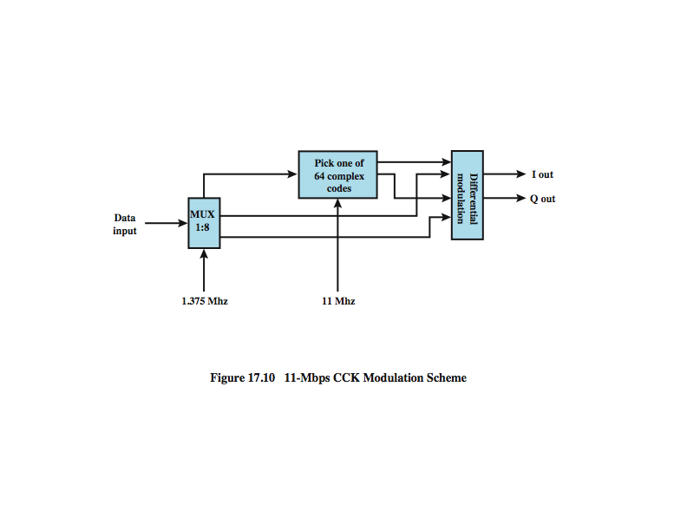
11-Mbps CCK Modulation Scheme
Notes:
The CCK modulation scheme is quite complex and is not examined in detail here. Stallings DCC9e Figure 17.9 provides an overview of the scheme for the 11-Mbps rate. Input data are treated in blocks of 8 bits at a rate of 1.375 MHz (8 bits/symbol × 1.375 MHz = 11 Mbps). Six of these bits are mapped into one of 64 codes sequences derived from a 64 × 64 matrix known as the Walsh matrix (discussed in [STAL05]). The output of the mapping, plus the two additional bits, forms the input to a QPSK modulator.
An optional alternative to CCK is known as packet binary convolutional coding (PBCC). PBCC provides for potentially more efficient transmission at the cost of increased computation at the receiver. PBCC was incorporated into 802.11b in anticipation of its need for higher data rates for future enhancements to the standard.

Slide 46
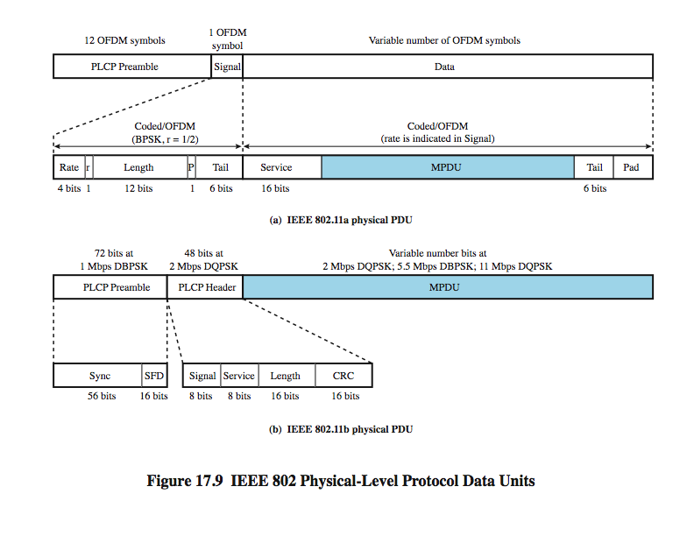
802.11b Physical Frame
Notes:
IEEE 802.11b defines two physical-layer frame formats, which differ only in the length of the preamble. The long preamble of 144 bits is the same as used in the original 802.11 DSSS scheme and allows interoperability with other legacy systems. The short preamble of 72 bits provides improved throughput efficiency. Stallings DCC9e Figure 17.10b illustrates the physical layer frame format with the short preamble. The PLCP Preamble field enables the receiver to acquire an incoming signal and synchronize the demodulator. It consists of two subfields: a 56-bit Sync field for synchronization, and a 16-bit start-of-frame delimiter (SFD). The preamble is transmitted at 1 Mbps using differential BPSK and Barker code spreading.
Following the preamble is the PLCP Header, which is transmitted at 2 Mbps using DQPSK. It consists of the following subfields:
Signal: Specifies the data rate at which the MPDU portion of the frame is transmitted.
Service: Only 3 bits of this 8-bit field are used in 802.11b. One bit indicates whether the transmit frequency and symbol clocks use the same local oscillator. Another bit indicates whether CCK or PBCC encoding is used. A third bit acts as an extension to the Length subfield.
Length: Indicates the length of the MPDU field by specifying the number of microseconds necessary to transmit the MPDU. Given the data rate, the length of the MPDU in octets can be calculated. For any data rate over 8 Mbps, the length extension bit from the Service field is needed to resolve a rounding ambiguity.
CRC: A 16-bit error-detection code used to protect the Signal, Service, and Length fields.
The MPDU field consists of a variable number of bits transmitted at the data rate specified in the Signal subfield. Prior to transmission, all of the bits of the physical layer PDU are scrambled

Slide 47
802.11a
Advantages over IEEE 802.11b:
IEEE 802.11a
utilizes more available bandwidth
provides much higher data rates
uses a relatively uncluttered frequency spectrum (5 GHz)uses
Universal Networking Information Infrastructure (UNNI)
UNNI-1 band (5.15 to 5.25 GHz) for indoor use
UNNI-2 band (5.25 to 5.35GHz) for indoor or outdoor
UNNI-3 band (5.725 to 5.825 GHz) for outdoor
uses OFDM
Notes:
Although 802.11b achieved a certain level of success, its limited data rate results in limited appeal. To meet the needs for a truly high-speed LAN, IEEE 802.11a was developed.
CHANNEL STRUCTURE
IEEE 802.11a makes use of the frequency band called the Universal Networking Information Infrastructure (UNNI), which is divided into three parts. The UNNI-1 band (5.15 to 5.25 GHz) is intended for indoor use; the UNNI-2 band (5.25 to 5.35 GHz) can be used either indoor or outdoor, and the UNNI-3 band (5.725 to 5.825 GHz) is for outdoor use.
IEEE 80211.a has several advantages over IEEE 802.11b/g:
IEEE 802.11a utilizes more available bandwidth than 802.11b/g. Each UNNI band provides four nonoverlapping channels for a total of 12 across the allocated spectrum.
IEEE 802.11a provides much higher data rates than 802.11b and the same maximum data rate as 802.11g.
IEEE 802.11a uses a different, relatively uncluttered frequency spectrum (5 GHz).
CODING AND MODULATION
Unlike the 2.4-GHz specifications, IEEE 802.11a does not use a spread spectrum scheme but rather uses orthogonal frequency division multiplexing (OFDM). Recall from Stallings DCC9e Section 11.2 that OFDM, also called multicarrier modulation, uses multiple carrier signals at different frequencies, sending some of the bits on each channel. This is similar to FDM. However, in the case of OFDM, all of the subchannels are dedicated to a single data source.
To complement OFDM, the specification supports the use of a variety of modulation and coding alternatives. The system uses up to 48 subcarriers that are modulated using BPSK, QPSK, 16-QAM, or 64-QAM. Subcarrier frequency spacing is 0.3125 MHz., and each subcarrier transmits at a rate of 250 kbaud. A convolutional code at a rate of 1/2, 2/3, or 3/4 provides forward error correction. The combination of modulation technique and coding rate determines the data rate.

Slide 48
802.11a Physical Frame
Notes:
Stallings DCC9e Figure 17.10a illustrates the physical layer frame format. The PLCP Preamble field enables the receiver to acquire an incoming OFDM signal and synchronize the demodulator. Next is the Signal field, which consists of 24 bits encoded as a single OFDM symbol. The Preamble and Signal fields are transmitted at 6 Mbps using BPSK. The signal field consists of the following subfields:
Rate: Specifies the data rate at which the data field portion of the frame is transmitted
r: reserved for future use
Length: Number of octets in the MAC PDU
P: An even parity bit for the 17 bits in the Rate, r, and Length subfields
Tail: Consists of 6 zero bits appended to the symbol to bring the convolutional encoder to zero state
The Data field consists of a variable number of OFDM symbols transmitted at the data rate specified in the Rate subfield. Prior to transmission, all of the bits of the Data field are scrambled (see Appendix 16B for a discussion of scrambling). The Data field consists of four subfields:
Service: Consists of 16 bits, with the first 7 bits set to zeros to synchronize the descrambler in the receiver, and the remaining 9 bits (all zeros) reserved for future use.
MAC PDU: Handed down from the MAC layer. The format is shown in Figure 17.8.
Tail: Produced by replacing the six scrambled bits following the MPDU end with 6 bits of all zeros; used to reinitialize the convolutional encoder.
Pad: The number of bits required to make the Data field a multiple of the number of bits in an OFDM symbol (48, 96, 192, or 288).

Slide 49
802.11g
higher-speed extension to 802.11b
operates in 2.4GHz band
compatible with 802.11b devices
combines physical layer encoding techniques used in 802.11 and 802.11b to provide service at a variety of data rates
ERP-OFDM for 6, 9, 12, 18, 24, 36, 48, 54Mbps rates
ERP-PBCC for 22 & 33Mbps rates
Notes:
IEEE 802.11g extends 802.11b to data rates above 20 Mbps, up to 54 Mbps. Like 802.11b, 802.11g operates in the 2.4-GHz range and thus the two are compatible. The standard is designed so that 802.11b devices will work when connected to an 802.11g AP, and 802.11g devices will work when connected to an 802.11b AP, in both cases using the lower 802.11b data rate.
IEEE 802.11g offers a wider array of data rate and modulation scheme options. IEEE 802.11g provides compatibility with 802.11 and 802.11b by specifying the same modulation and framing schemes as these standards for 1, 2, 5.5, and 11 Mbps. At data rates of 6, 9, 12, 18, 24, 36, 48, and 54 Mbps, 802.11g adopts the 802.11a OFDM scheme, adapted for the 2.4 GHz rate; this is referred to as ERP-OFDM, with ERP standing for extended rate physical layer. In addition, an ERP-PBCC scheme is used to provide data rates of 22 and 33 Mbps.

Slide 50
Data Rate vs Distance (m)
Notes:
The IEEE 802.11 standards do not include a specification of speed versus distance objectives. Different vendors will give different values, depending on environment. Stallings DCC9e Table 17.5, based on [LAYL04] gives estimated values for a typical office environment.

Slide 51
802.11n
IEEE 802.11n has enhancements in three general areas:
multiple-input-multiple-output (MIMO) antenna architecture
most important enhancement
radio transmission scheme
increased capacity
MAC enhancements
most significant change is to aggregate multiple MAC frames into a single block for transmission
Notes:
IEEE 802.11n
With increasing demands being placed on wireless LANs, the 802.11 committee looked for ways to increase the data throughput and overall capacity of 802.11 networks. The goal of this effort is to not just increase the bit rate of the transmitting antennas but to increase the effective throughput of the network. Increasing effective throughput involves not only looking at the signal encoding scheme, but also at the antenna architecture and the MAC frame structure. The result of these efforts is a package of improvements and enhancements embodied in IEEE 802.11n. This standard is defined to operate in both the 2.4-GHz and the 5-GHz bands and can therefore be made upwardly compatible with either 802.11a or 802.11b/g.
IEEE 802.11n embodies changes in three general areas: use of MIMO, enhancements in radio transmission, and MAC enhancements. We briefly examine each of these.
Multiple-input-multiple-output (MIMO) antenna architecture is the most important of the enhancements provided by 802.11n. A discussion of MIMO is beyond our scope, so we content ourselves with a brief overview (see Stallings DCC9e Figure 17.11). In a MIMO scheme, the transmitter employs multiple antennas. The source data stream is divided into n substreams, one for each of the n transmitting antennas. The individual substreams are the input to the transmitting antennas (multiple input). At the receiving end, m antennas receive the transmissions from the n source antennas via a combination of line-of-sight transmission and multipath. The outputs from the m receiving antennas (multiple output) are combined with the signals from the other receive radios. With a lot of complex math, the result is a much better receive signal than can be achieved with either a single antenna or multiple frequency channels. 802.11n defines a number of different combinations for the number of transmitters and the number of receivers, from 2 × 1 to 4 × 4. Each additional transmitter or receiver in the system increases the SNR (signal-to-noise ratio). However, the incremental gains from each additional transmitter or receiver diminish rapidly. The gain in SNR is large for each step from 2×1 to 2×2 and to 3×2, but the improvement with 3×3 and beyond is relatively small [CISC07].
In addition to MIMO, 802.11n makes a number of changes in the radio transmission scheme to increase capacity. The most significant of these techniques, known as channel bonding, combines two 20-MHz channels to create a 40-MHz channel. Using OFDM, this allows for twice as many subchannels, doubling the transmission rate.
Finally, 802.11 provides some MAC enhancements. The most significant change is to aggregate multiple MAC frames into a single block for transmission. Once a station acquires the medium for transmission, it can transmit long packets without significant delays between transmissions. The receiver sends a single block acknowledgement. Frame aggregation can result in significantly improved efficiency in the use of the transmission capacity.
Figure 17.12 gives an indication of the effectiveness of 802.11n compared to 802.11g [DEBE07]. The chart shows the average throughput per user on a shared system. As expected, the more active users competing for the wireless capacity, the smaller the average throughput per user. IEEE 802.11n provides a significant improvement, especially for networks in which a small number of users are actively competing for transmission time.

Slide 52
Access and Privacy Services - Authentication
used to establish station identity
wired LANs assume physical connection gives authority to use LAN
not a valid assumption for wireless LANs
802.11 supports several authentication schemes
does not mandate any particular scheme
from relatively insecure handshaking to public-key encryption
802.11 requires mutually acceptable, successful authentication before association
Notes:
There are two characteristics of a wired LAN that are not inherent in a wireless LAN.
1. In order to transmit over a wired LAN, a station must be physically connected to the LAN. On the other hand, with a wireless LAN, any station within radio range of the other devices on the LAN can transmit. In a sense, there is a form of authentication with a wired LAN, in that it requires some positive and presumably observable action to connect a station to a wired LAN.
2. Similarly, in order to receive a transmission from a station that is part of a wired LAN, the receiving station must also be attached to the wired LAN. On the other hand, with a wireless LAN, any station within radio range can receive. Thus, a wired LAN provides a degree of privacy, limiting reception of data to stations connected to the LAN.
IEEE 802.11 defines three services that provide a wireless LAN with these two features:
Authentication: Used to establish the identity of stations to each other. In a wired LAN, it is generally assumed that access to a physical connection conveys authority to connect to the LAN. This is not a valid assumption for a wireless LAN, in which connectivity is achieved simply by having an attached antenna that is properly tuned. The authentication service is used by stations to establish their identity with stations they wish to communicate with. IEEE 802.11 supports several authentication schemes and allows for expansion of the functionality of these schemes. The standard does not mandate any particular authentication scheme, which could range from relatively unsecure handshaking to public-key encryption schemes. However, IEEE 802.11 requires mutually acceptable, successful authentication before a station can establish an association with an AP.

Slide 53
Access and Privacy Services Deauthentication & Privacy
Deauthentication
invoked whenever an existing authentication is to be terminated
Privacy
used to prevent messages being read by others
802.11 allows optional use of encryption
original WEP security features were weak
subsequently 802.11i and WPA alternatives evolved giving better security
Notes:
Deauthentication: This service is invoked whenever an existing authentication is to be terminated.
Privacy: Used to prevent the contents of messages from being read by other than the intended recipient. The standard provides for the optional use of encryption to assure privacy.
Wireless LAN Security Standards
The original 802.11 specification included a set of security features for privacy and authentication that, unfortunately, were quite weak. For privacy, 802.11 defined the Wired Equivalent Privacy (WEP) algorithm. The privacy portion of the 802.11 standard contained major weaknesses. Subsequent to the development of WEP, the 802.11i task group has developed a set of capabilities to address the WLAN security issues. In order to accelerate the introduction of strong security into WLANs, the Wi-Fi Alliance promulgated Wi-Fi Protected Access (WPA) as a Wi-Fi standard. WPA is a set of security mechanisms that eliminates most 802.11 security issues and was based on the current state of the 802.11i standard. As 802.11i evolves, WPA will evolve to maintain compatibility.

Slide 54

Summary
wireless LAN alternatives
IEEE 802.11 architecture and services
802.11 Medium Access Control
802.11 Physical Layers
802.11, 802.11a, 802.11b, 802.11g
access and privacy services
security considerations
Notes:
Stallings DCC9e Chapter17 summary.

